Slide 1
Develop Your Apps without Limits.
The OpenShift Platform

Slide 2
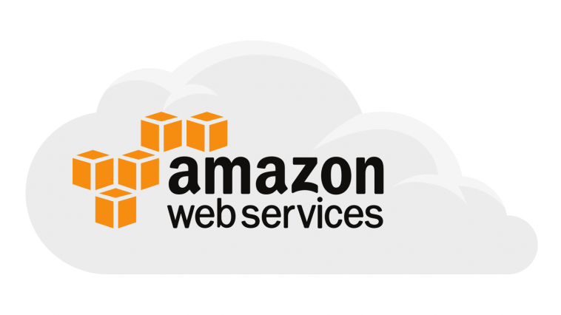
The OpenShift Platform:
Is up and running on Amazon Web Services (AWS, a remote cloud environment)
Runs on RedHat Linux
Allows you to play with new technologies
Allows you to build your own applications on top of it
Sounds amazing, right?
The OpenShift Platform
on AWS

Slide 3
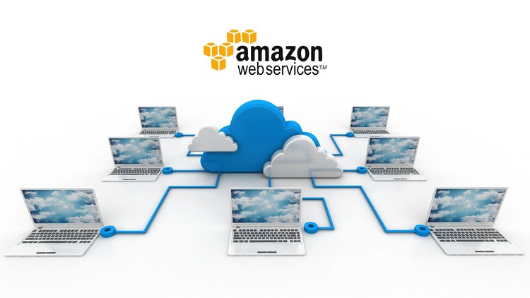
The OpenShift Platform
on AWS
But…gaining access and working in the remote cloud environment
...might not be a good idea.

Slide 4
The OpenShift Platform
Restricted Access
There is a strict policy describing how to gain access to the Amazon cloud to ensure that all environments are secure and the platform runs with accurate settings.
So, is there any solution?

Slide 5
The OpenShift Platform
in a Local Env
Yes, of course :)
Our team has been introduced a concept how to build your local environment where all developers can:
Freely implement
Have freedom to explore the platform
Develop and test their ideas without access limits

Slide 6

The OpenShift Platform
in a Local Env
We have applied a VirtualBox solution together with a base Linux image, CentOS, so instead of connecting to the remote cloud environment, you can easily build the platform on your virtual machine.
local virtual environment

Slide 7
The OpenShift Platform
on a Virtual Machine
How it works?
Your local virtual environment:
Allows you to run the platform, even when you use the Windows operating system (CentOS is set as the Linux image)
Enables you to control your development environment
Is built with Packer + additional tools such as Cygwin
Once it’s ready to use, you can run the platform, use all environmental tools and an Internet connection

Slide 8
The OpenShift Platform
on a Virtual Machine
Technically speaking:
Your local virtual environment + the OpenShift platform:
Allow you to run the platform in the mirrored production environment
Use Maven, Git, Java
Use CNTLM to handle Internet access via a Sabre corporate proxy

Slide 9
The OpenShift Platform
Q&A
Want to give a try? We will support you :)
We publish all news on our blog where you can also leave your comments and participate in discussions: http://vxu.wp-interview.com/
To check how the local virtual environment works on a daily basis, go to our documentation where you will find a step-by-step guide how to set it up: https://nataliakatrynska.github.io/

